Slide 1

FPT University
Android programMing
Lesson 2
Version 1.0

Slide 2
Agenda
Android Architecture
Application Components
Activity Lifecycles
Handling Android Activity State Changes
Saving and Restoring the State of an Android Activity

Slide 3
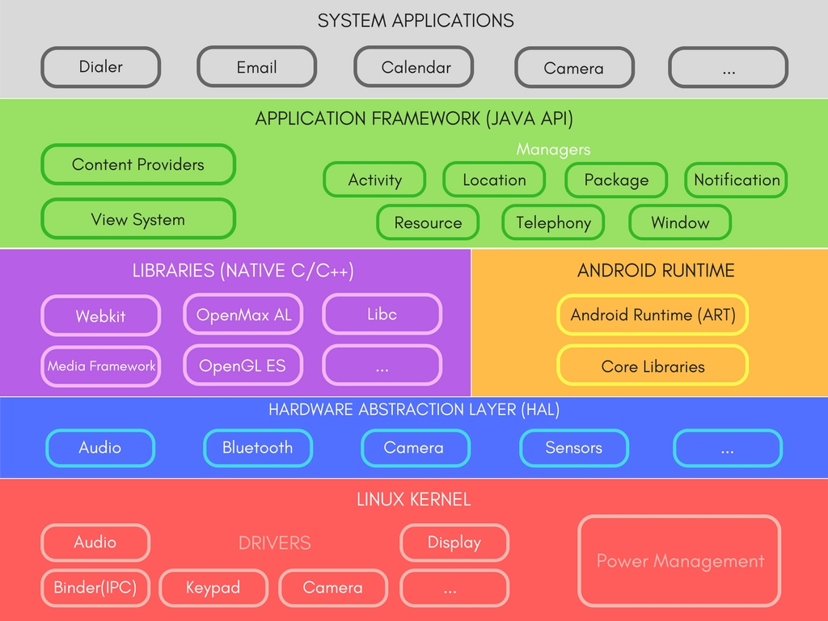
Android Architecture
Notes:
SGL = Scalable Graphics Library
SSL = Secured socket layout

Slide 4
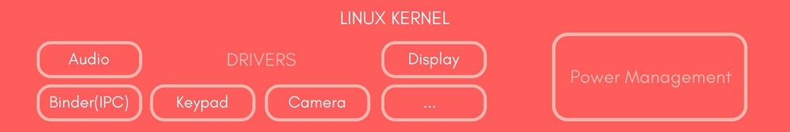
Android Architecture
Linux kernel
provides a low level of abstraction between the device hardware and the upper layers of the Android software stack
Contains all low level drivers for various hardware components support.
Notes:
Memory, process management, threading etc.
Network stack
Driver model
Security and more.

Slide 5
Android Architecture
Hardware Abstraction Layer (HAL)
Provides Abstraction between hardware and rest of the software stack.

Slide 6
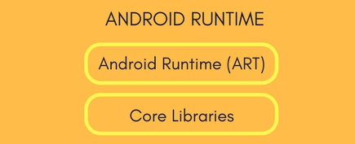
Android Architecture
Android Runtime (ART)
Designed to run apps in a constrained environment that has limited muscle power in terms of battery, processing and memory.
Notes:
Since Android 5.0, each app runs in its own process within its own instance of ART virtual machine, which makes process management more crucial.
ART uses DEX files, which is a type of bytecode, specially designed for Android, which helps ART to manage memory more efficiently.
Contains set of core libraries that enables developers to write Android Apps using Java Programming.
Prior to Android 5.0, Dalvik was used as Android runtime.
ART is capable of both Ahead-of-time (AOT) and Just-in-time (JIT) compilation.
It also has a very efficient garbage collection.

Slide 7
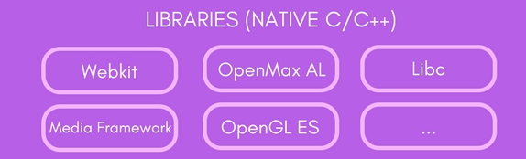
Android Architecture
Libraries
Exposed to developers through Android Application Framework.
Contains C/C++ libraries used by components of Android Systems.
Notes:
SQLite Library used for data storage and light in terms of mobile memory footprints and task execution.
WebKit Library mainly provides Web Browsing engine and a lot more related features.
The surface manager library is responsible for rendering windows and drawing surfaces of various apps on the screen.
The media framework library provides media codecs for audio and video.
The OpenGl (Open Graphics Library) and SGL(Scalable Graphics Library) are the graphics libraries for 3D and 2D rendering, respectively.
The FreeType Library is used for rendering fonts.

Slide 8
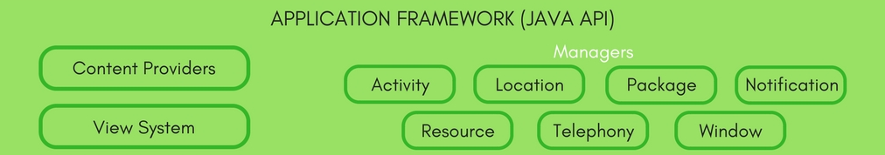
Android Architecture
Application Framework
It is a collection of APIs written in Java, which gives developers access to the complete feature set of Android OS.
Notes:
Activity Manager: Manages the Lifecycle of apps & provide common navigation back stack.
Window Manager: Manages windows and drawing surfaces, and is an abstraction of the surface manager library.
Content Providers: Enables application to access data from other applications or to share their own data i.e it provides mechanism to exchange data among apps.
View System: Contains User Interface building blocks used to build an application's UI, including lists, grids, texts, boxes, buttons,etc. and also performs the event management of UI elements(explained in later tutorials).
Package Manager: Manages various kinds of information related to the application packages that are currently installed on the device.
Telephony Manager: Enables app to use phone capabilities of the device.
Resource Manager: Provides access to non-code resources (localized Strings, bitmaps, Graphics and Layouts).
Location Manager: Deals with location awareness capabilities.
Notification Manager: Enable apps to display custom alerts in the status bar.

Slide 9
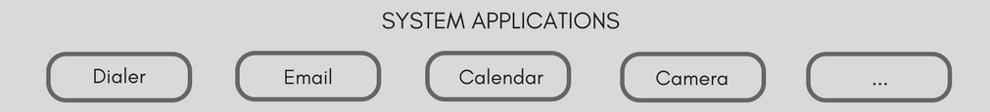
Android Architecture
Applications
Top of the Android Application Stack, is occupied by the System apps and tonnes of other Apps that users can download from Android's Official Play Store, also known as Google Play Store.

Slide 10
Application Components
Android Activities
A subclass of Activity class
A single user interface screen
Reuseable

Slide 11
Application Components
Android Intents
Intents are the mechanism by which one activity is able to launch another and implement the flow through the activities that make up an application
Explicit intent
Implicit intent
Notes:
Explicit intent : Start the Send Email activity in the Gmail app
Implicit intent : Start a Send Email screen in any activity that can do the job.\

Slide 12
Application Components
Broadcast Intents
Is a system wide intent that is sent out to all applications that have registered an “interested” Broadcast Receiver
<activity android:name=".ExampleActivity" android:icon="@drawable/app_icon"> <intent-filter> <action android:name="android.intent.action.SEND" /> <category android:name="android.intent.category.DEFAULT" /> <data android:mimeType="text/plain" /> </intent-filter> </activity>

Slide 13
Application Components
Android Services
Android Services are processes that run in the background and do not have a user interface
Android Services are ideal for situations where an application needs to continue performing tasks but does not necessarily need a user interface to be visible to the user
Notes:
Broadcast intent: called as intent filter that register

Slide 14
Application Components
Content Providers
Content Providers implement a mechanism for the sharing of data between applications
Data can be shared in the form of a file or an entire SQLite database

Slide 15
Application Components
Application Manifest
The glue that pulls together the various elements that comprise an application is the Application Manifest file

Slide 16
Application Components
Application Resources
Android application package will also typically contain a collection of resource files.
These files contain resources such as the strings, images, fonts and colors that appear in the user interface together with the XML representation of the user interface layouts

Slide 17
Application Components
Application Context When an application is compiled, a class named R is created that contains references to the application resources. The application manifest file and these resources combine to create what is known as the Application Context. This context used in the application code to gain access to the application resources at runtime

Slide 18
Activity Lifecycles
Android Applications and Resource Management
If the system identifies that resources on the device are reaching capacity it will take steps to terminate processes to free up memory. the system base on priority and state to determine which process to terminate.

Slide 19
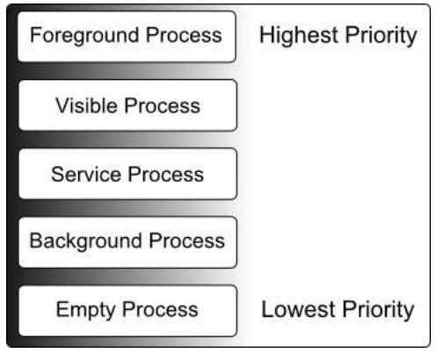
Activity Lifecycles
Android Process States
The current state of a process is defined by the highest-ranking active component

Slide 20
Activity Lifecycles
Inter-Process Dependencies states of a process can never be ranked lower than another process that it is currently serving. Ex a service process acting as the content provider for a foreground process

Slide 21
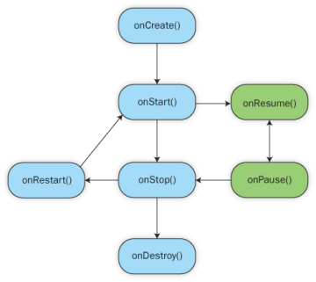
Activity Lifecycles
The Activity Lifecycle
activities also transition through different states during the execution lifetime of an application.

Slide 22
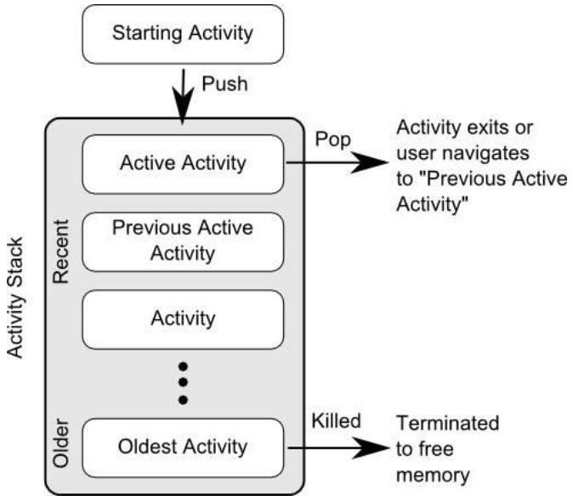
Activity Lifecycles
The Activity Stack

Slide 23
Activity Lifecycles
Activity States
Active / Running
Paused
Stopped
Killed

Slide 24
Activity Lifecycles
Configuration Changes
Configuration change that impacts the appearance of an activity
Handling State Change
Application will, in most circumstances, be notified by the runtime system of the changes and given the opportunity to react accordingly

Slide 25
Handling Activity State Changes
The Android Activity Lifecycle Methods
The Activity class contains a number of lifecycle methods which act as event handlers when the state of an Activity changes. Each change has a support method.

Slide 26
Handling Activity State Changes
Activity Lifetimes Entire Lifetime –The term “entire lifetime” is used to describe everything that takes place within an activity between the initial call to the onCreate() method and the call to onDestroy() prior to the activity terminating. Visible Lifetime – Covers the periods of execution of an activity between the call to onStart() and onStop(). During this period the activity is visible to the user though may not be the activity with which the user is currently interacting. Foreground Lifetime – Refers to the periods of execution between calls to the onResume() and onPause() methods

Slide 27
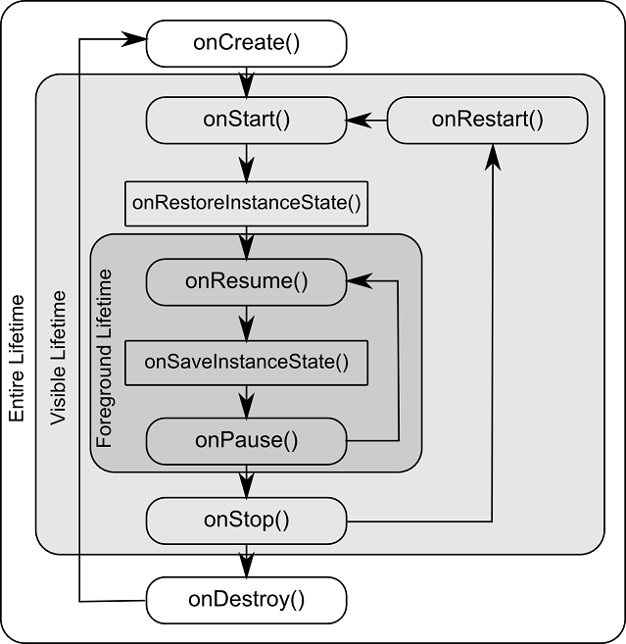
Handling Activity State Changes

Slide 28
Disabling Configuration Change Restarts
Activity may indicate that it is not to be restarted in the event of certain configuration changes. This is achieved by adding an android:configChanges directive to the manifest file of the activity
<activity android:name=".DemoActivity" android:configChanges="orientation|fontScale" android:label="@string/app_name">

Slide 29
Saving and Restoring the State of an Android Activity
Default Saving of User Interface State
The Bundle Class The Bundle class also contains a set of methods that can be used to get and set key-value pairs for a variety of data types

Slide 30
Saving and Restoring the State of an Android Activity
Saving the State
Restoring the State
@Override protected void onSaveInstanceState(Bundle outState) { super.onSaveInstanceState(outState); final EditText textBox = (EditText) findViewById(R.id.editText); CharSequence userText = textBox.getText(); outState.putCharSequence("savedText", userText); }
@Override protected void onRestoreInstanceState(Bundle savedInstanceState) { super.onRestoreInstanceState(savedInstanceState); final EditText textBox = (EditText) findViewById(R.id.editText); CharSequence userText = savedInstanceState.getCharSequence("savedText"); textBox.setText(userText); }

Slide 31
Saving and Restoring the State of an Android Activity
Automatic saving and restoring
<EditText android:id="@+id/editText" android:layout_width="wrap_content" android:layout_height="wrap_content" android:ems="10" android:inputType="textPersonName" android:saveEnabled="true" android:text="Name" app:layout_constraintBottom_toBottomOf="parent" app:layout_constraintLeft_toLeftOf="parent" app:layout_constraintRight_toRightOf="parent" app:layout_constraintTop_toTopOf="parent" />

Slide 32

End of Lesson 2

Slide 33
Thank you!

